Slide 1




Page 01
Software Project Lab 01
C SYNTAX
CHECKER

Slide 2
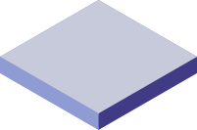
Page 02
SUBMITTED TO
SUBMITTED BY
DR REZVI SHAHARIAR
ASSOCIATE PROFESSOR
IIT, DU
G. M. RASHIDUL ISLAM RAHAT
ROLL : BSSE 1517

Slide 3
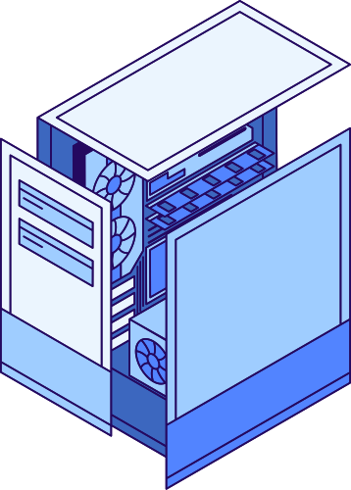
Page 03
DEFINITION AND SCOPE
This project is a C-based Syntax Checker designed to parse and evaluate the syntactic correctness of C code. It reads code line-by-line from an input file, identifies potential errors in built-in functions, loop constructs, and formatting, and provides detailed feedback to help improve code quality. Additionally, it analyzes the code to count occurrences of built-in functions and keywords, enabling developers to optimize their usage. The tool aims to aid programmers in identifying common coding mistakes and fostering better coding practices.

Slide 4
Page 04
The project focuses on static code analysis for C programming, emphasizing syntax validation and keyword analysis. It identifies syntax errors, such as missing semicolons or misused loop structures, and evaluates the frequency and usage of key programming constructs. This helps enhance code quality, enforce coding standards, and ensure better maintainability in software development.
KEY
CONCEPTS

Slide 5
Liceria Tech
FEATURES OF THE
C SYNTAX CHECKER
Syntax Error Detection:
Identifies common syntax errors in C code, such as missing semicolons, unmatched brackets, and incorrect usage of control structures like loops and conditionals.
Keyword Analysis:
Counts occurrences of key C programming keywords (e.g., if, for, while, return) to provide insights into code composition and complexity.
Customizable Analysis:
Flexible code structure that allows for easy modification to add or update rules for syntax checking and keyword evaluation.

Slide 6
Liceria Tech
FEATURES OF THE
C SYNTAX CHECKER
Automated Code Scanning:
Provides automated analysis for large codebases by reading C files and producing reports on detected issues and keyword usage.
Improved Code Quality:
Aims to enhance code readability, maintainability, and adherence to best practices by identifying and flagging problematic constructs.

Slide 7
Liceria Tech
TECHNICAL
ARCHITECTURE
WORKFLOW :
INPUT → TOKENIZATION → PARSING → ERROR REPORTING.
Core Components:
Lexical Analyzer.
Syntax Analyzer.
Error Handler

Slide 8
Liceria Tech
FUTURE ENHANCEMENTS
Adding semantic error detection.
Integration with popular IDE
Expanding to support other languages.

Slide 9



Liceria Tech
THANK YOU!
+123-456-7890
www.reallygreatsite.com
hello@reallygreatsite.com

